Slide 1
Integrated Project Data Science Development of an autocorrection system of bank checks

Slide 2






Our team
Youssef MANSOUR
Molka MRAD
Houssem OUERDIANE
Dhia BEN AMOR
Haithem GHARBI
Aicha CHAABA

Slide 3
Table of contents
01.
02.
03.
Introduction
Buisness Objectives
Data Science Objectives
04.
05.
Data Modeling & Evaluation
Conclusion

Slide 4
Introduction
01

Slide 5
Business Objectives
02

Slide 6
Achieve the autocorrection of the amount in a check
Manipulate a huge amount of data
Assure the security in the whole process

Slide 7
Detection of the different parts of the check
Comparison between the amount in numbers and the amount in letters
Verifying the validity of the date (the check expires after 3 years and a week)

Slide 8
Check the existence of the signature and its validity
Identify the language written in the check
Identify different handwritings

Slide 9
Data Science Objectives
03

Slide 10
Computer Vision
NLP
CNN
RNN

Slide 11
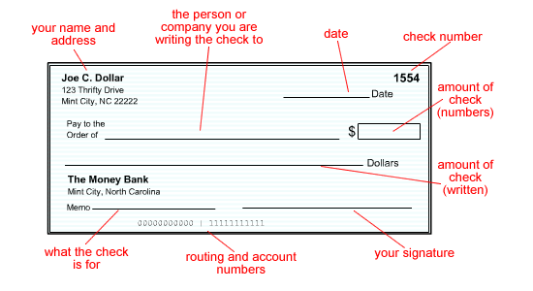
Computer Vision
Preprocessing
Segmentation
To perform image processing on digital images
To improve the image data (features) by suppressing unwanted distortions and/or enchancement of some important image features
Capturing the components of a scanned bank check image

Slide 12
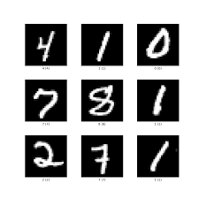
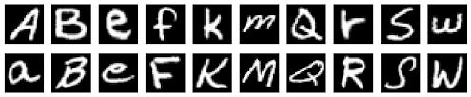
Convolutional Neural Network (CNN)
Identifying the digits from courtesy amount image segment and characters from legal amount segment using CNN EMNIST dataset for Latin letters and MNIST dataset for numbers

Slide 13
Natural Language Processing NLP
NLP is the field of Artificial Intelligence that relates lingual to Computer Science, in which we will :
Identify mispelled words
Find distance away
Filtering
Calculate probabilities of words

Slide 14
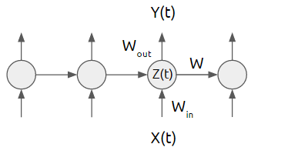
Recurrent Neural Network (RNN)
To extract the handwritten amount in letters from the check, we will be using RNN (Recurrent Neural Network) to predict the multipe handwritten numbers and add them to our database.

Slide 15
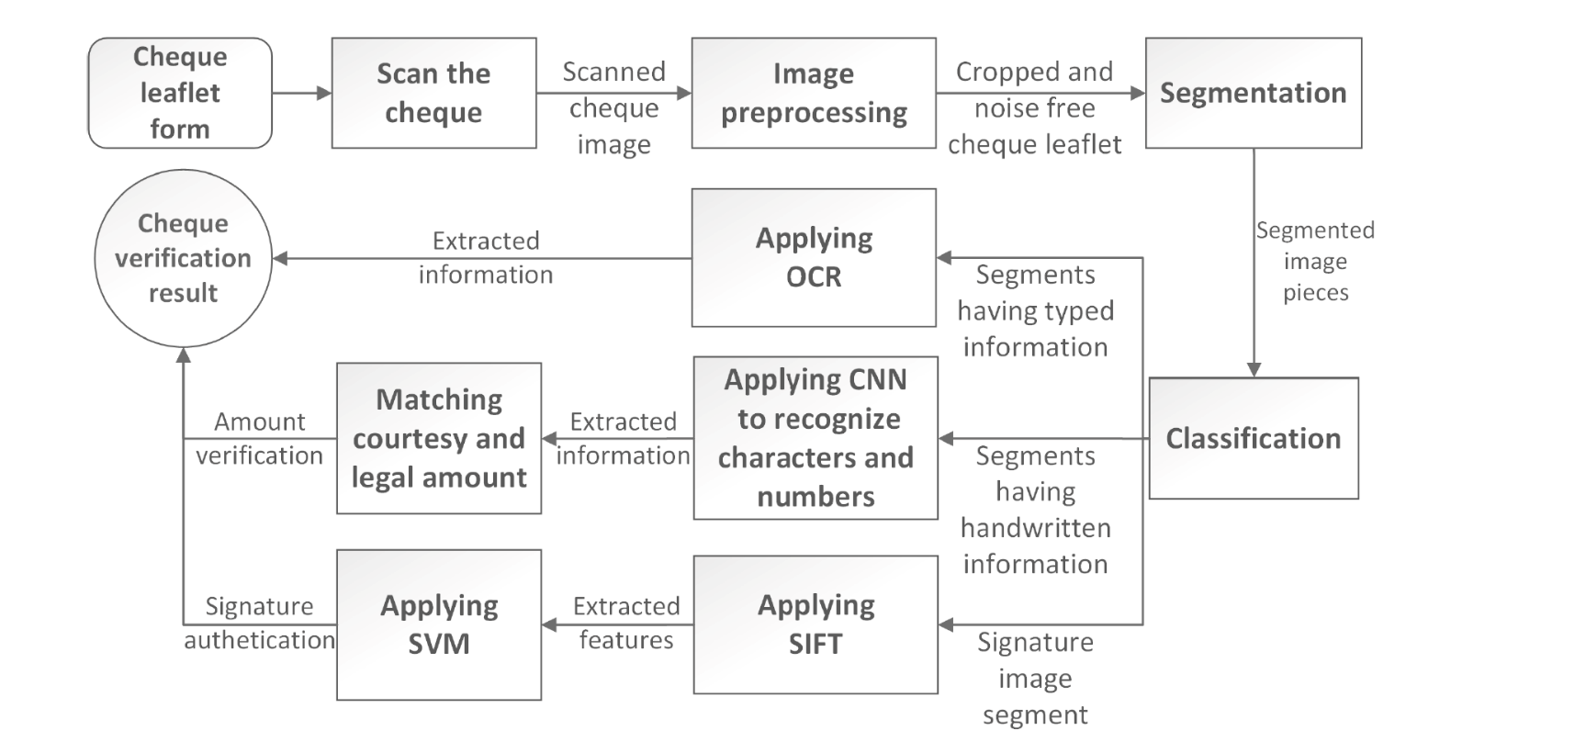

To conclude it all

Slide 16
Data Modeling & Evaluation
04

Slide 17
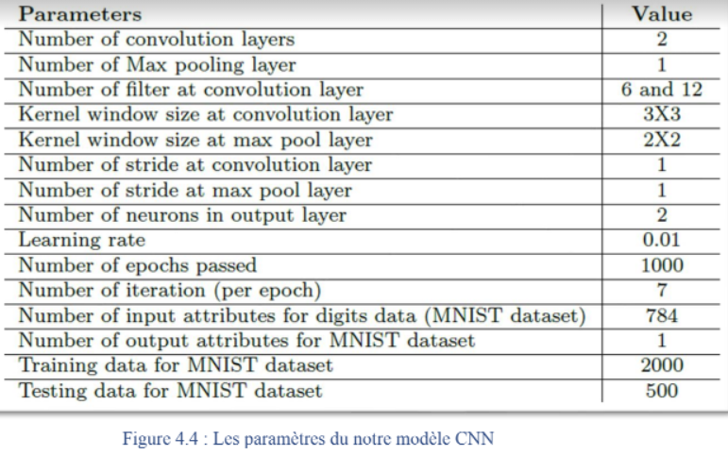
Courtesy Amount Prediction

Slide 18
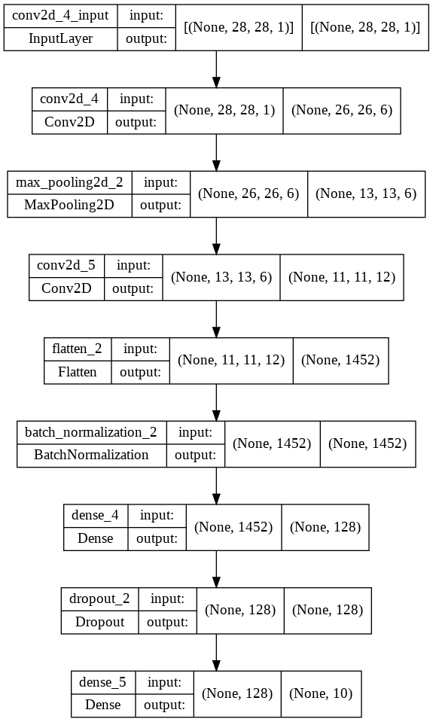
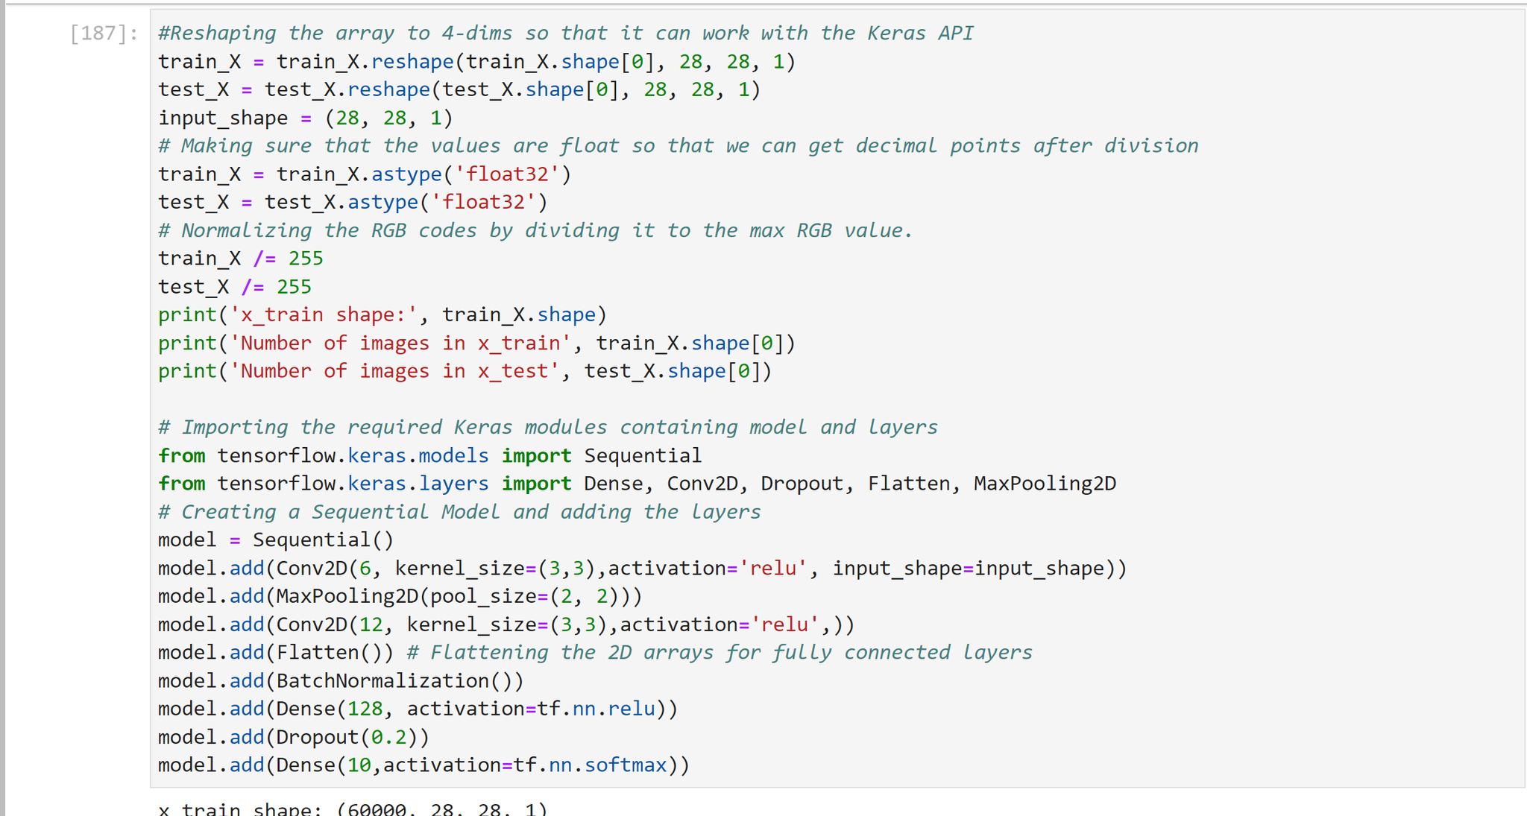
Courtesy Amount Prediction

Slide 19
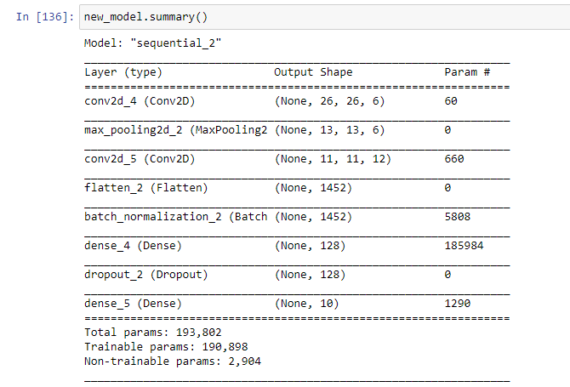
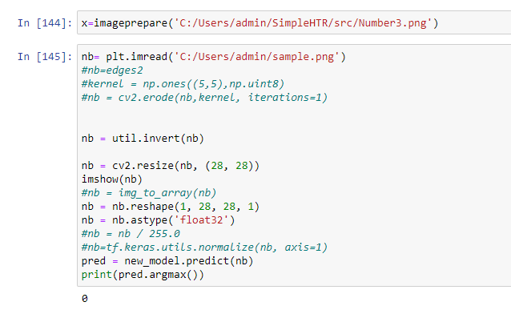
Courtesy Amount Prediction

Slide 20
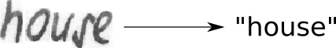
Legal Amount Prediction
Handwritten Text Recognition (HTR) system implemented with TensorFlow (TF) and trained on the IAM off-line HTR dataset. This Neural Network (NN) model recognizes the text contained in the images of segmented words as shown in the illustration below. As these word-images are smaller than images of complete text-lines, the NN can be kept small and training on the CPU is feasible. 3/4 of the words from the validation-set are correctly recognized and the character error rate is around 10%.

Slide 21
Legal Amount Prediction
About the model :
The implementation only depends on numpy, cv2 and tensorflow imports. It consists of 5 CNN layers, 2 RNN (LSTM) layers and the CTC loss and decoding layer. The illustration below gives an overview of the NN (green: operations, pink: data flowing through NN) and here follows a short description:
-The input image is a gray-value image and has a size of 128x32
-5 CNN layers map the input image to a feature sequence of size 32x256
-2 LSTM layers with 256 units propagate information through the sequence and map the sequence to a matrix of size 32x80. Each matrix-element represents a score for one of the 80 characters at one of the 32 time-steps
-The CTC layer either calculates the loss value given the matrix and the ground-truth text (when training), or it decodes the matrix to the final text with best path decoding or beam search decoding (when inferring)
-Batch size is set to 50

Slide 22
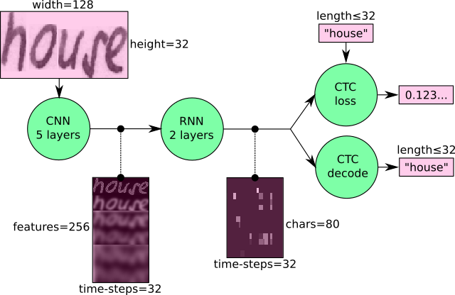
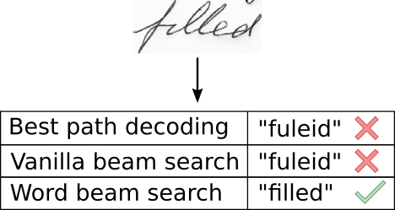
Legal Amount Prediction
Overview :

Slide 23
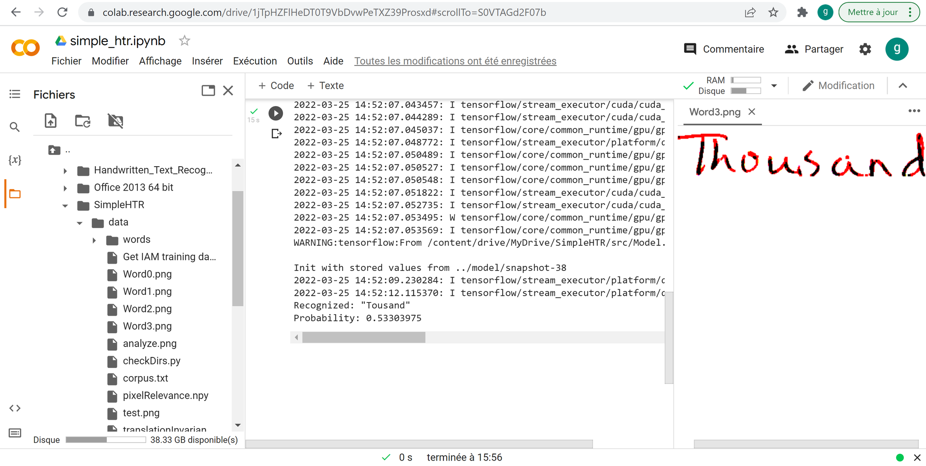
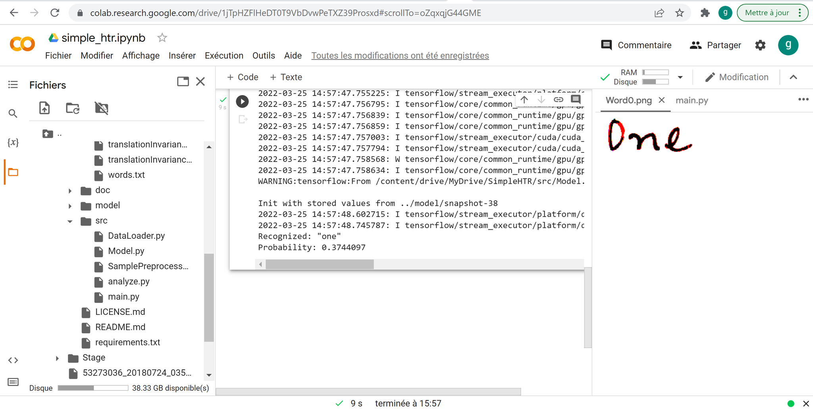
Legal Amount Prediction

Slide 24
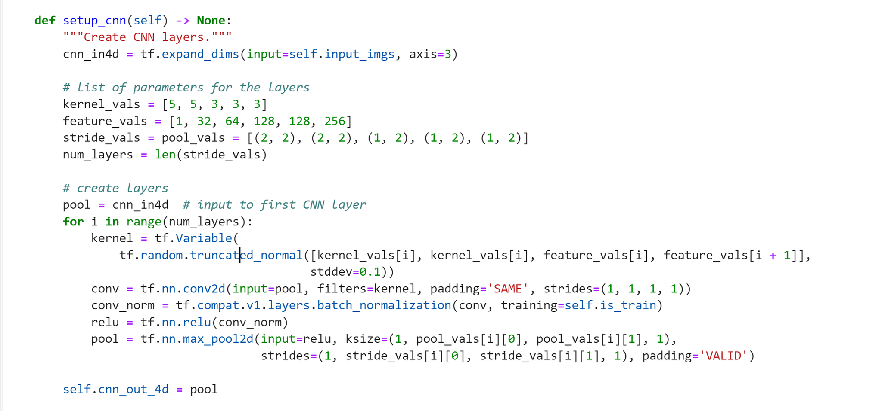
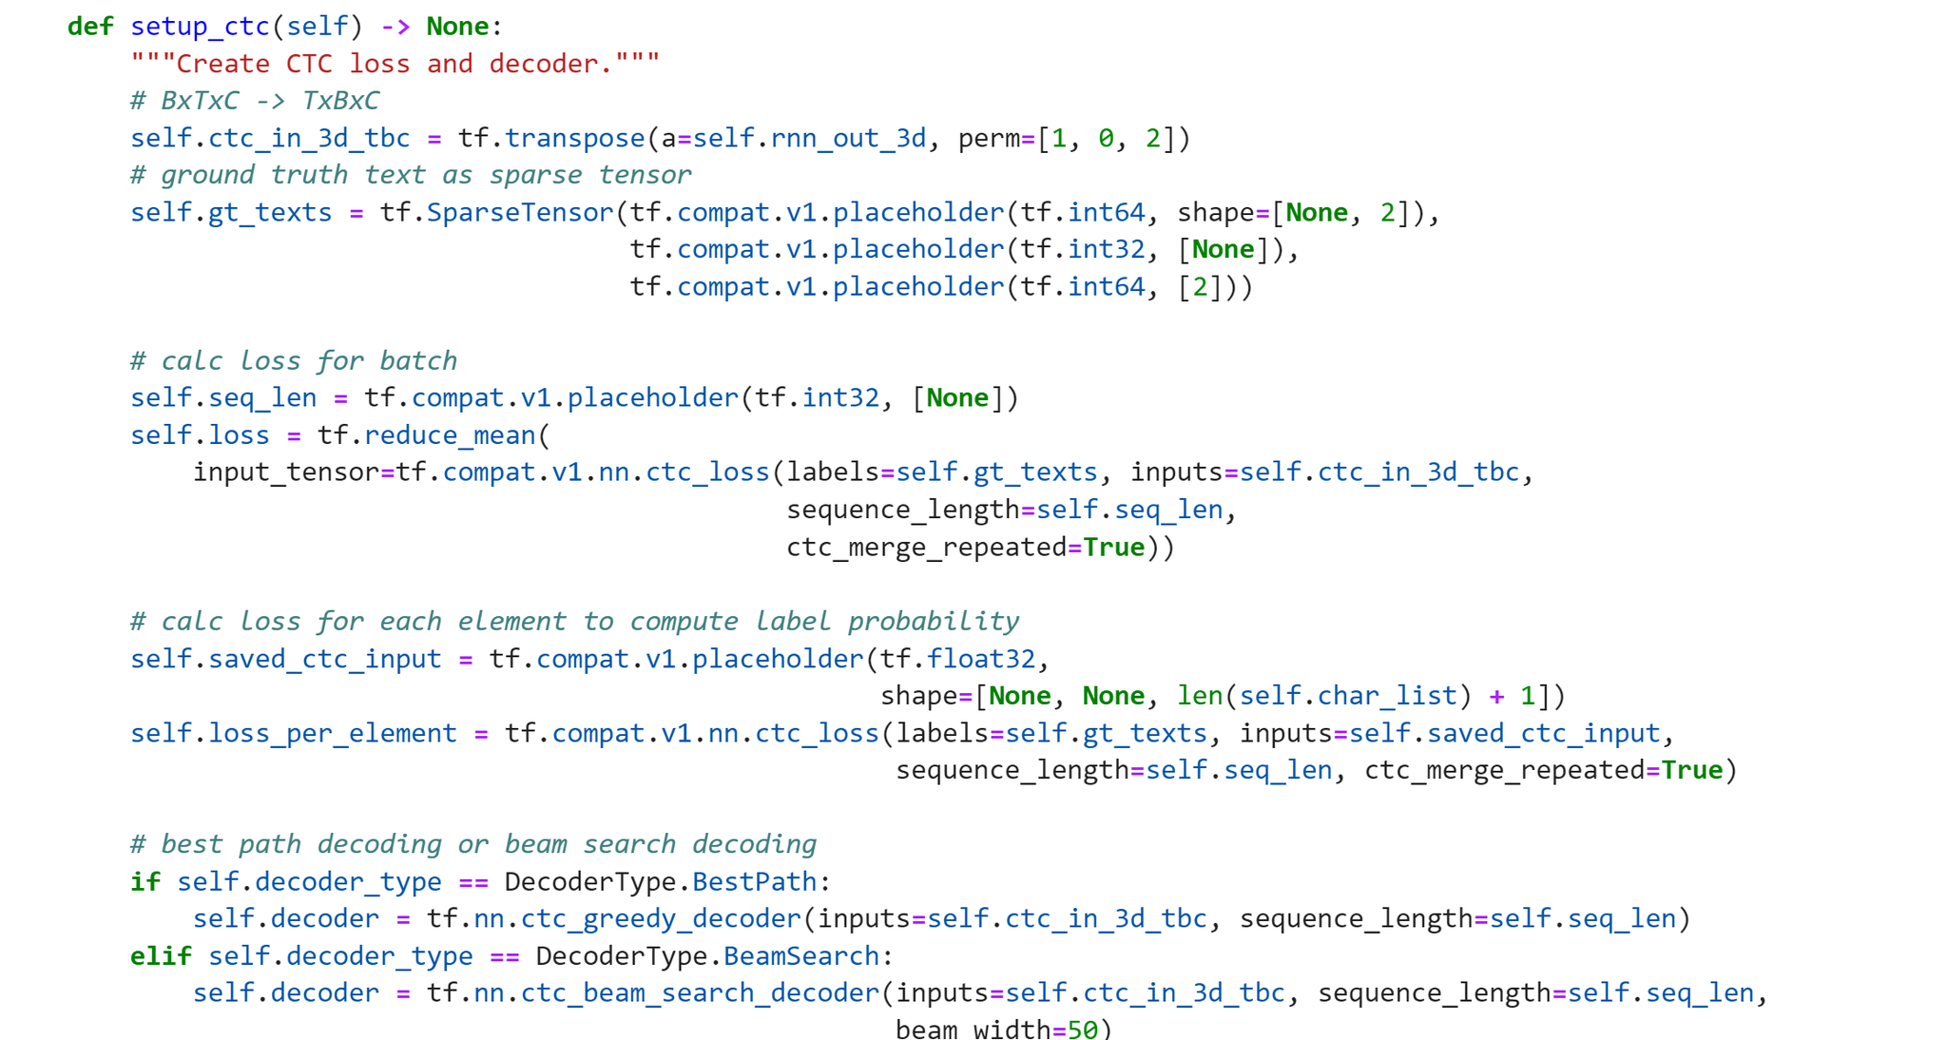
Legal Amount Prediction

Slide 25
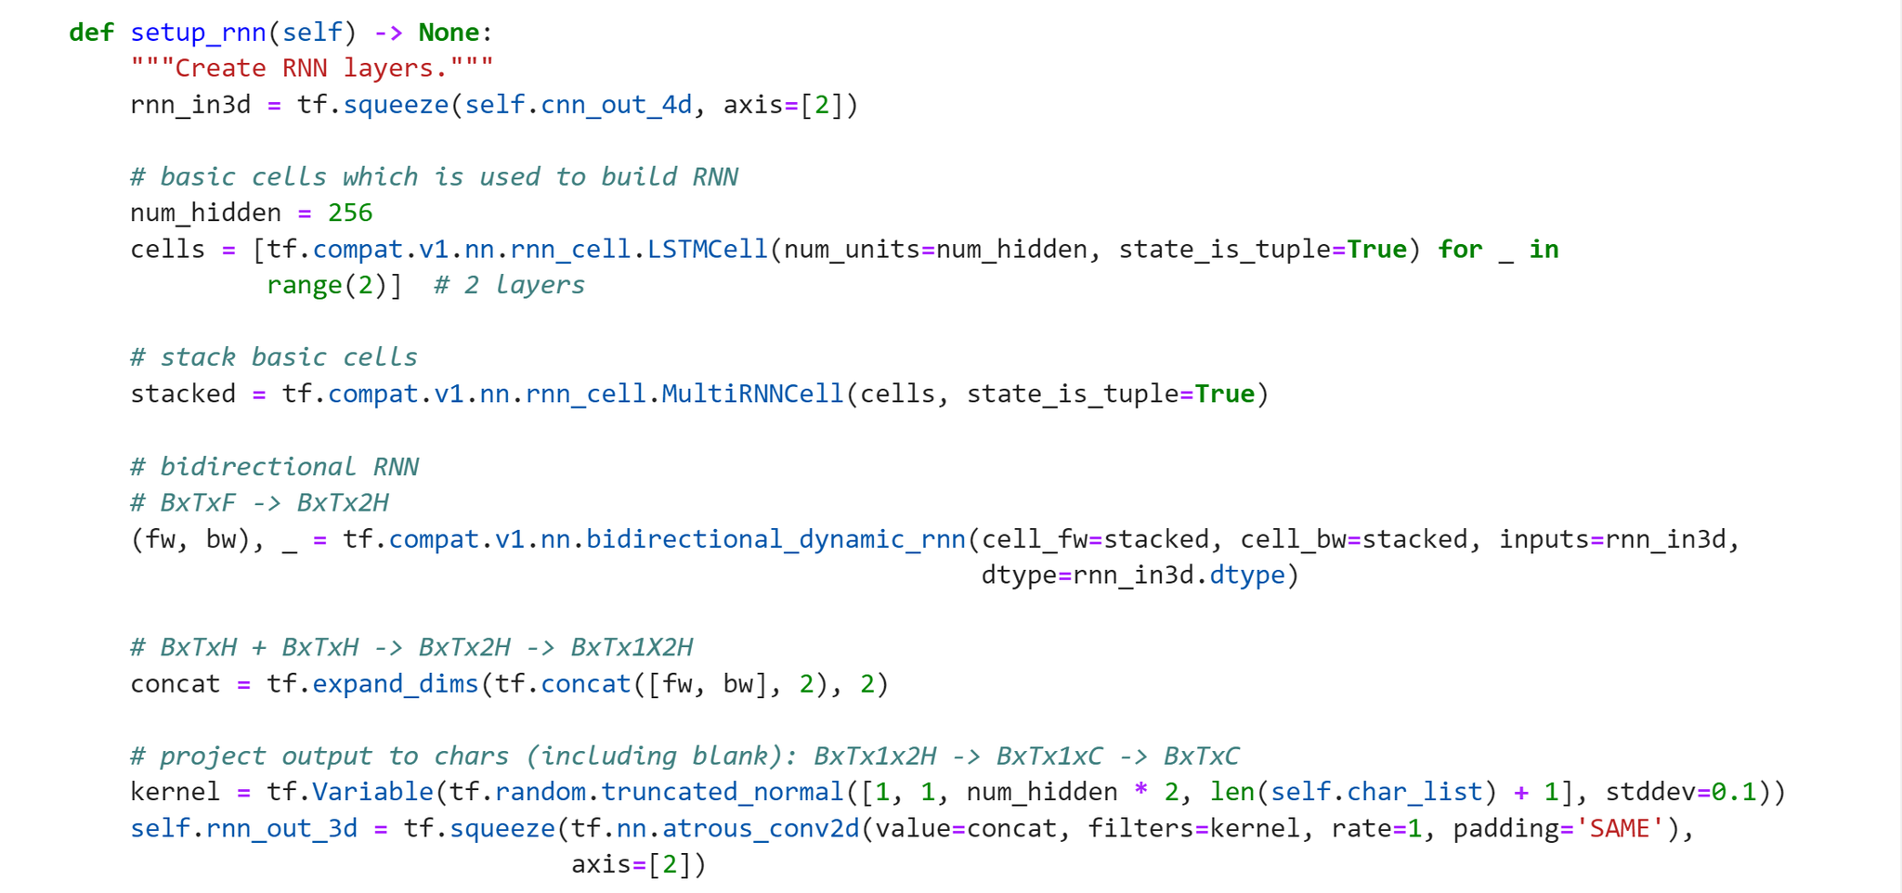
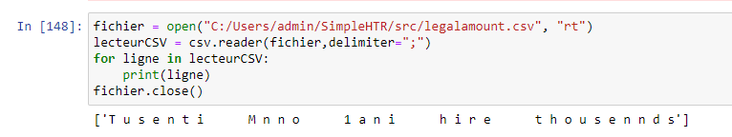
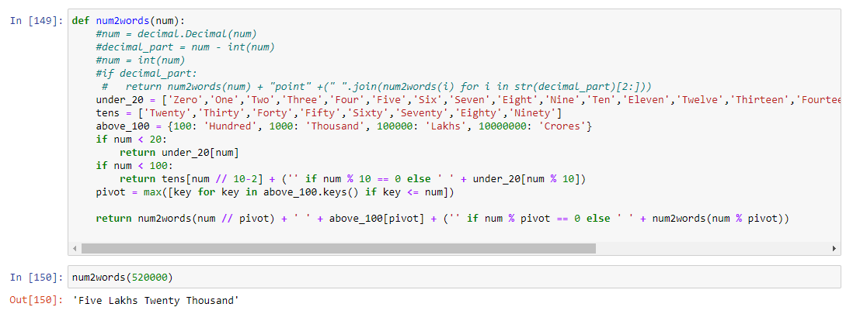
Legal Amount Prediction

Slide 26
Auto Correction
Using NLP :
Find strings that are N-edit-distance away from the misspelled word
INSERT - a letter should be added.
DELETE - removes a letter.
SWAP - swaps two adjacent letters.
REPLACE - changes one letter to another.
The probabilities of the words are calculated based on the following formula:
P(w) = C(w)/V
P(w)- the probability of a word w.
C(w) - number of times (frequency) word appears in the vocabulary dictionary.
V - the total sum of words in the dictionary.

Slide 27
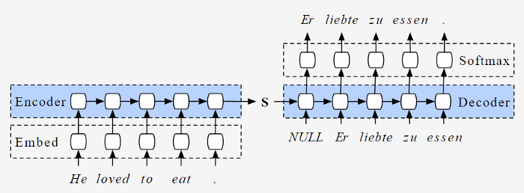
Auto Correction
Using Deep Learning :
Sequence to Sequence (often abbreviated to seq2seq) models is a special class of Recurrent Neural Network architectures that we typically use (but not restricted) to solve complex Language problems like Machine Translation, Question Answering, creating Chatbots, Text Summarization, etc. Here we consider Spell-checker and Autocorrect task similar to Machine Translation, thus using the same model.

Slide 28
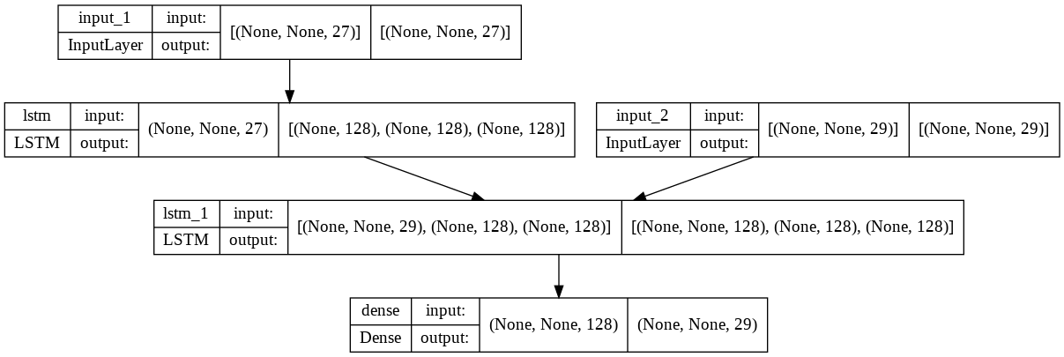
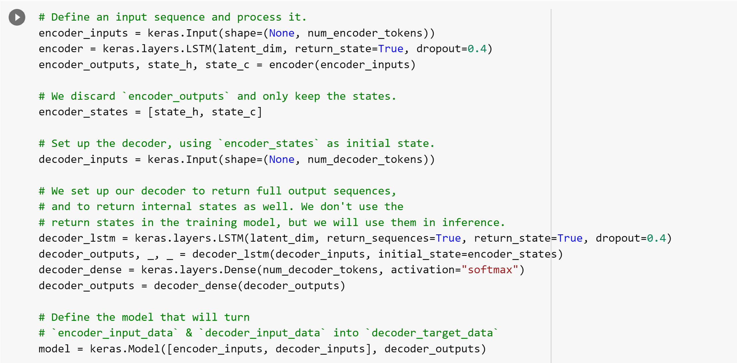
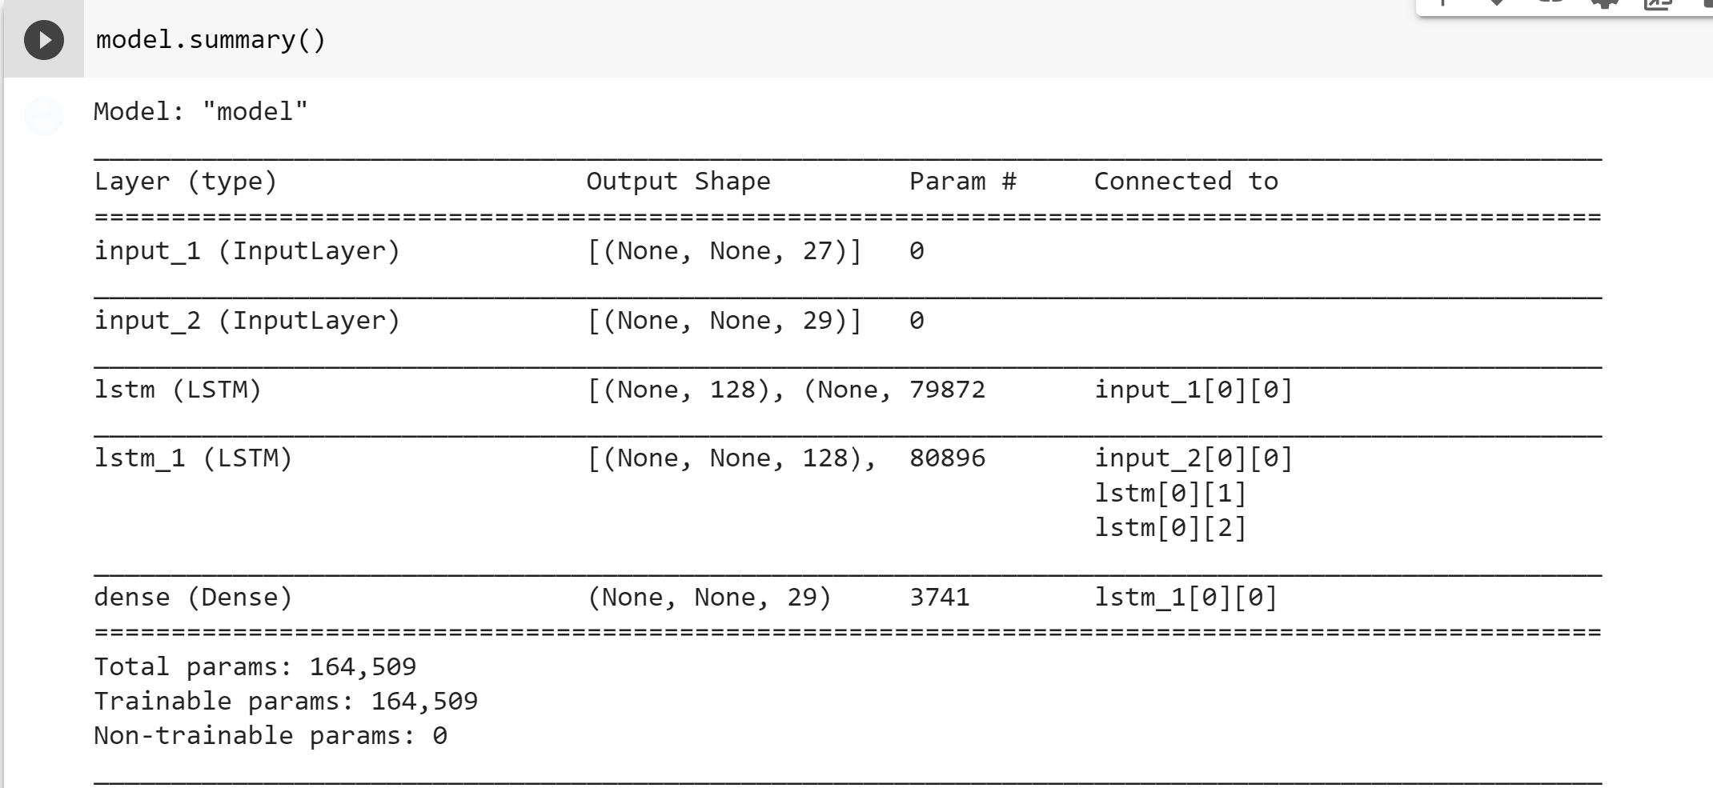
Auto Correction

Slide 29
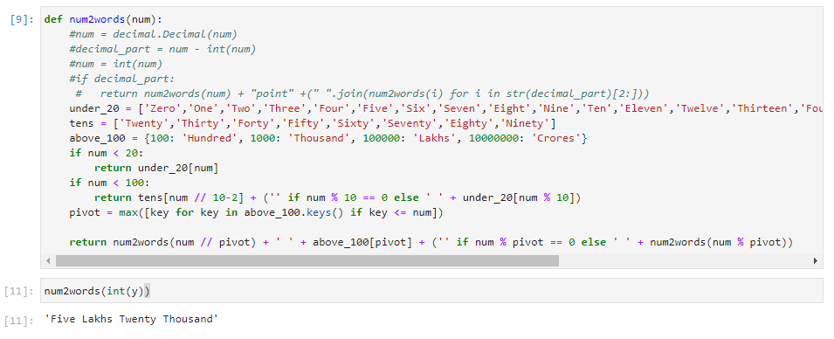
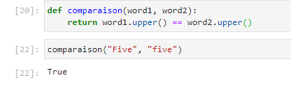
Comparison between the legal amount and the courtesy amount

Slide 30
Conclusion
05

Slide 31
Thanks!
Do you have any questions?

